Slide 1

Somatic Mod
Ian Colquhoun

Slide 2
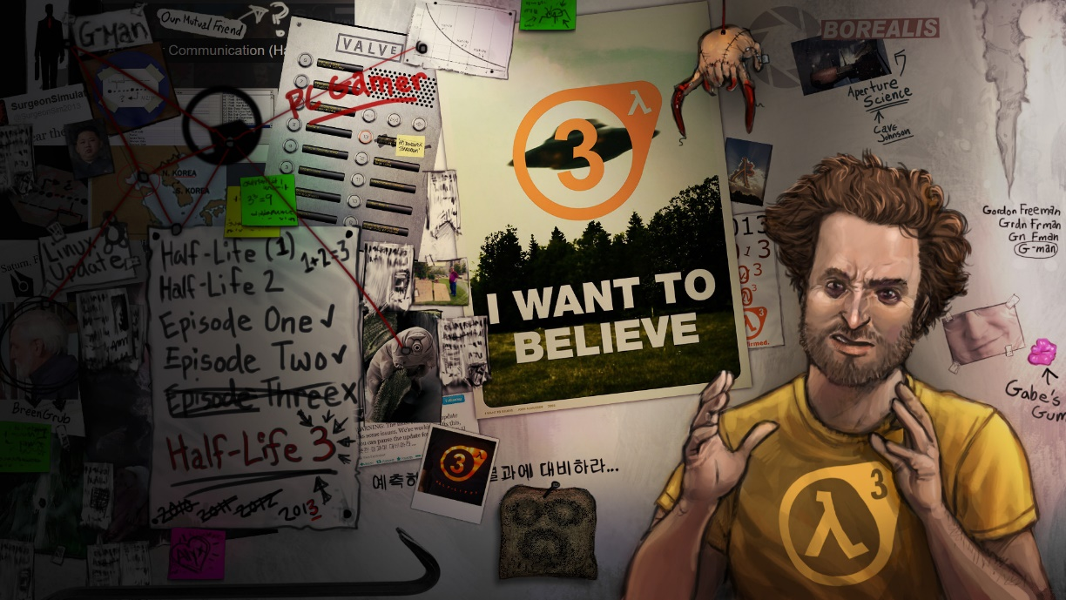
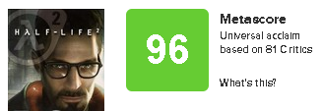
MARKET OVERVIEW
Fans have given up on Half-Life 3
Fans are interested in more Half-Life content
HL2 sold 10m copies and has a large modding community

Slide 3
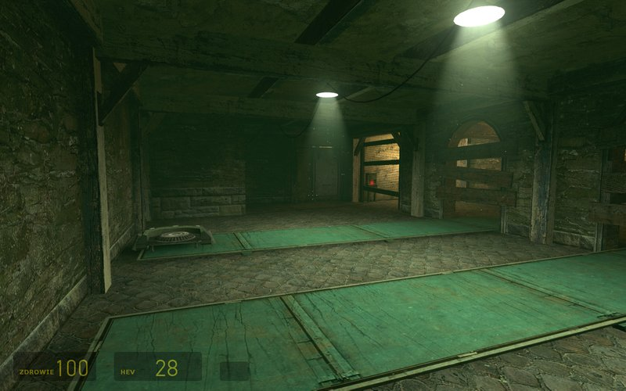
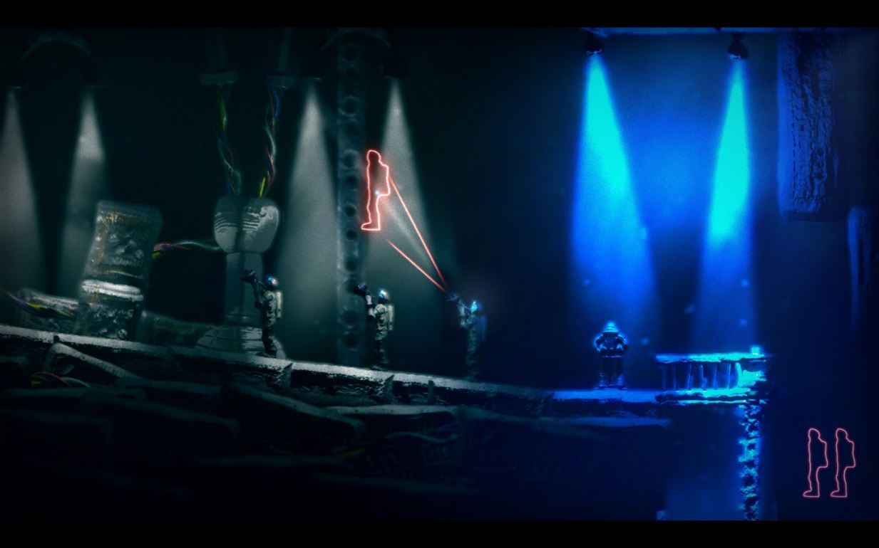
PROJECT OVERVIEW
Half-Life 2 Mod (elaborate)
Clone yourself to solve puzzles

Slide 4
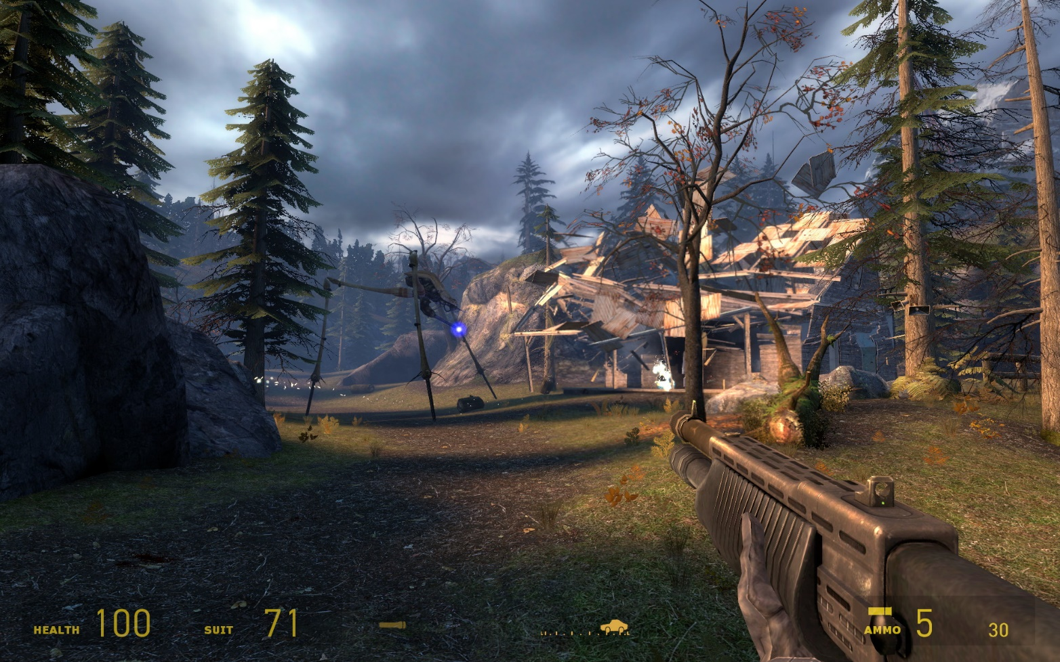
PROJECT FEATURES
Classic HL gameplay (blend of combat, exploration, puzzle)
New mechanic keeps design fresh
New audio and art

Slide 5
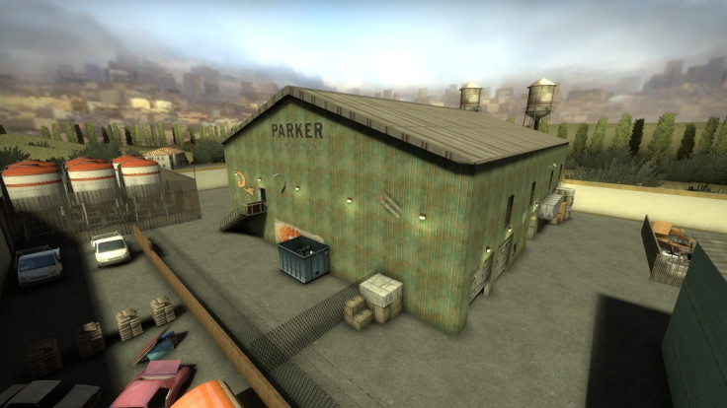

COMMERCIALIZATION PLAN
Release for free on Steam Workshop
Proof of delivering polished linear experience
Level design portfolio
Rob

Slide 6
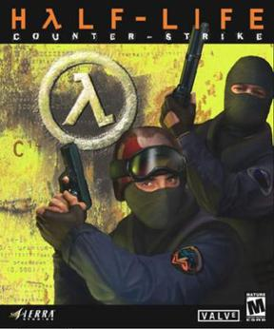
LEGAL CONSIDERATIONS
Uses HL2 assets
Released for non-profit
Valve has a history of supporting fan content

Slide 7
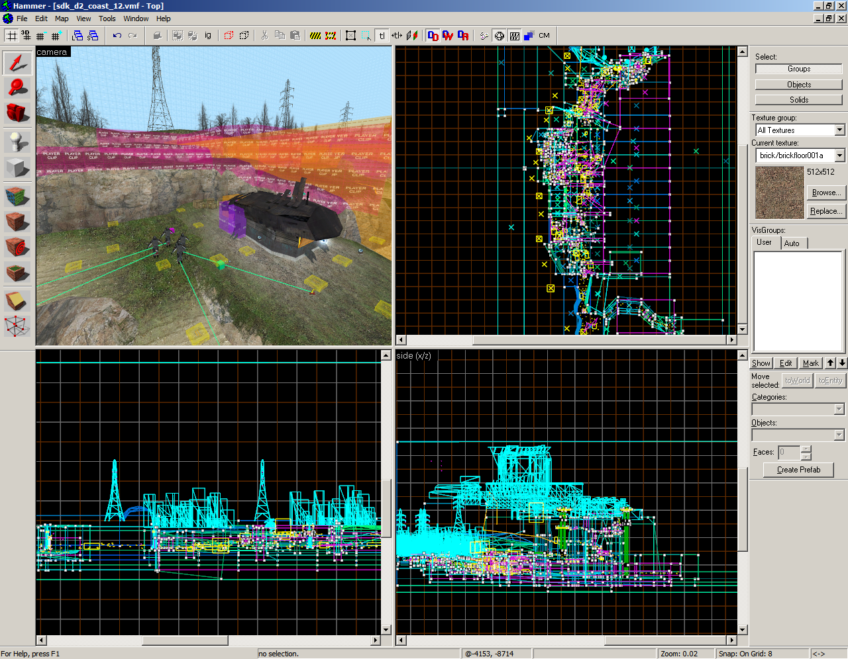
HIGH LEVEL DEVELOPMENT SCHEDULE
Deliver ~20-minute level with new mechanic, sounds and art
Polished level that can ideally stand alongside base game
Mechanic prototype:
Level greybox:
AI placement
Art pass:
Polish:

Slide 8
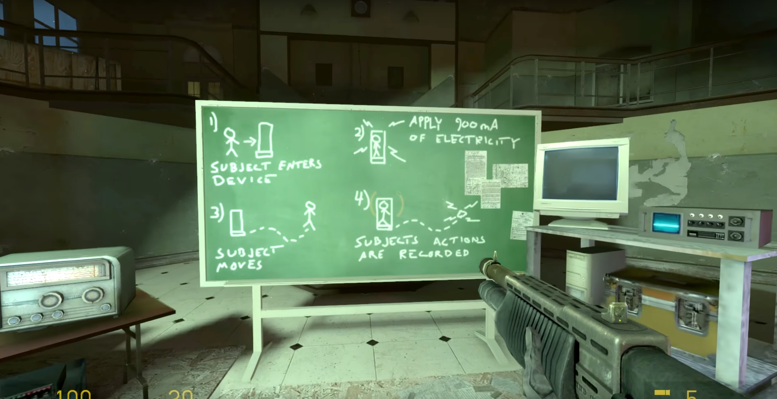
HIGH LEVEL DEVELOPMENT TEAM
Coder to implement puzzle mechanic, particle effects (don’t need a wiz)
Sound guy for SFX, music (Ethan) (not story driven, no VA)
2D/3D artist for custom textures and models (Dan can rig, model, texture)
THIS IS SCALEABLE – can work with stock assets

Slide 9
MENTOR
Primary, Brad – Level design is the focus
Secondary, Mike – Mechanics design and puzzles

Slide 10
Thank you!

